Slide 1

Customer Shopping Behavior Analysis
Transforming transactional retail data into strategic business insights through Python, SQL, and Power BI

Slide 2

PROJECT OVERVIEW
Understanding Customer Purchase Patterns
Business Objective
Dataset
Tools Used
Analyze spending behavior, product performance, and seasonal trends
3,900 customer records with 18 attributes
Python, SQL, Power BI for end-to-end analysis

Slide 3

DATA FOUNDATION
Dataset Structure
Key Attributes
3.9K
Demographics: Age, Gender, Location
Transactions: Purchase Amount, Category, Season
Customer Records
Behavior: Subscription Status, Discount Usage
18
Engagement: Review Rating, Purchase Frequency
Data Attributes

Slide 4


DATA PREPARATION
Data Quality & Preprocessing
01
Initial Exploration
Validated data types and summary statistics using pandas
02
Missing Data Handling
Imputed 37 missing Review Ratings using category median
03
Feature Engineering
Created age_group and purchase_frequency_days columns
04
Database Integration
Loaded cleaned data into MySQL for SQL analysis

Slide 5
ANALYSIS
Key SQL Queries Executed
1
Revenue by Gender
Total revenue generated by male vs female customers
2
High-Value Discount Users
Customers using discounts but spending above average
3
Top-Rated Products
Top 10 products with highest average review ratings
4
Shipping Behavior
Average purchase amount by shipping type
5
Subscription Impact
Spending behavior: subscribed vs non-subscribed
6
Customer Segmentation
New, Returning, and Loyal customer categories

Slide 6

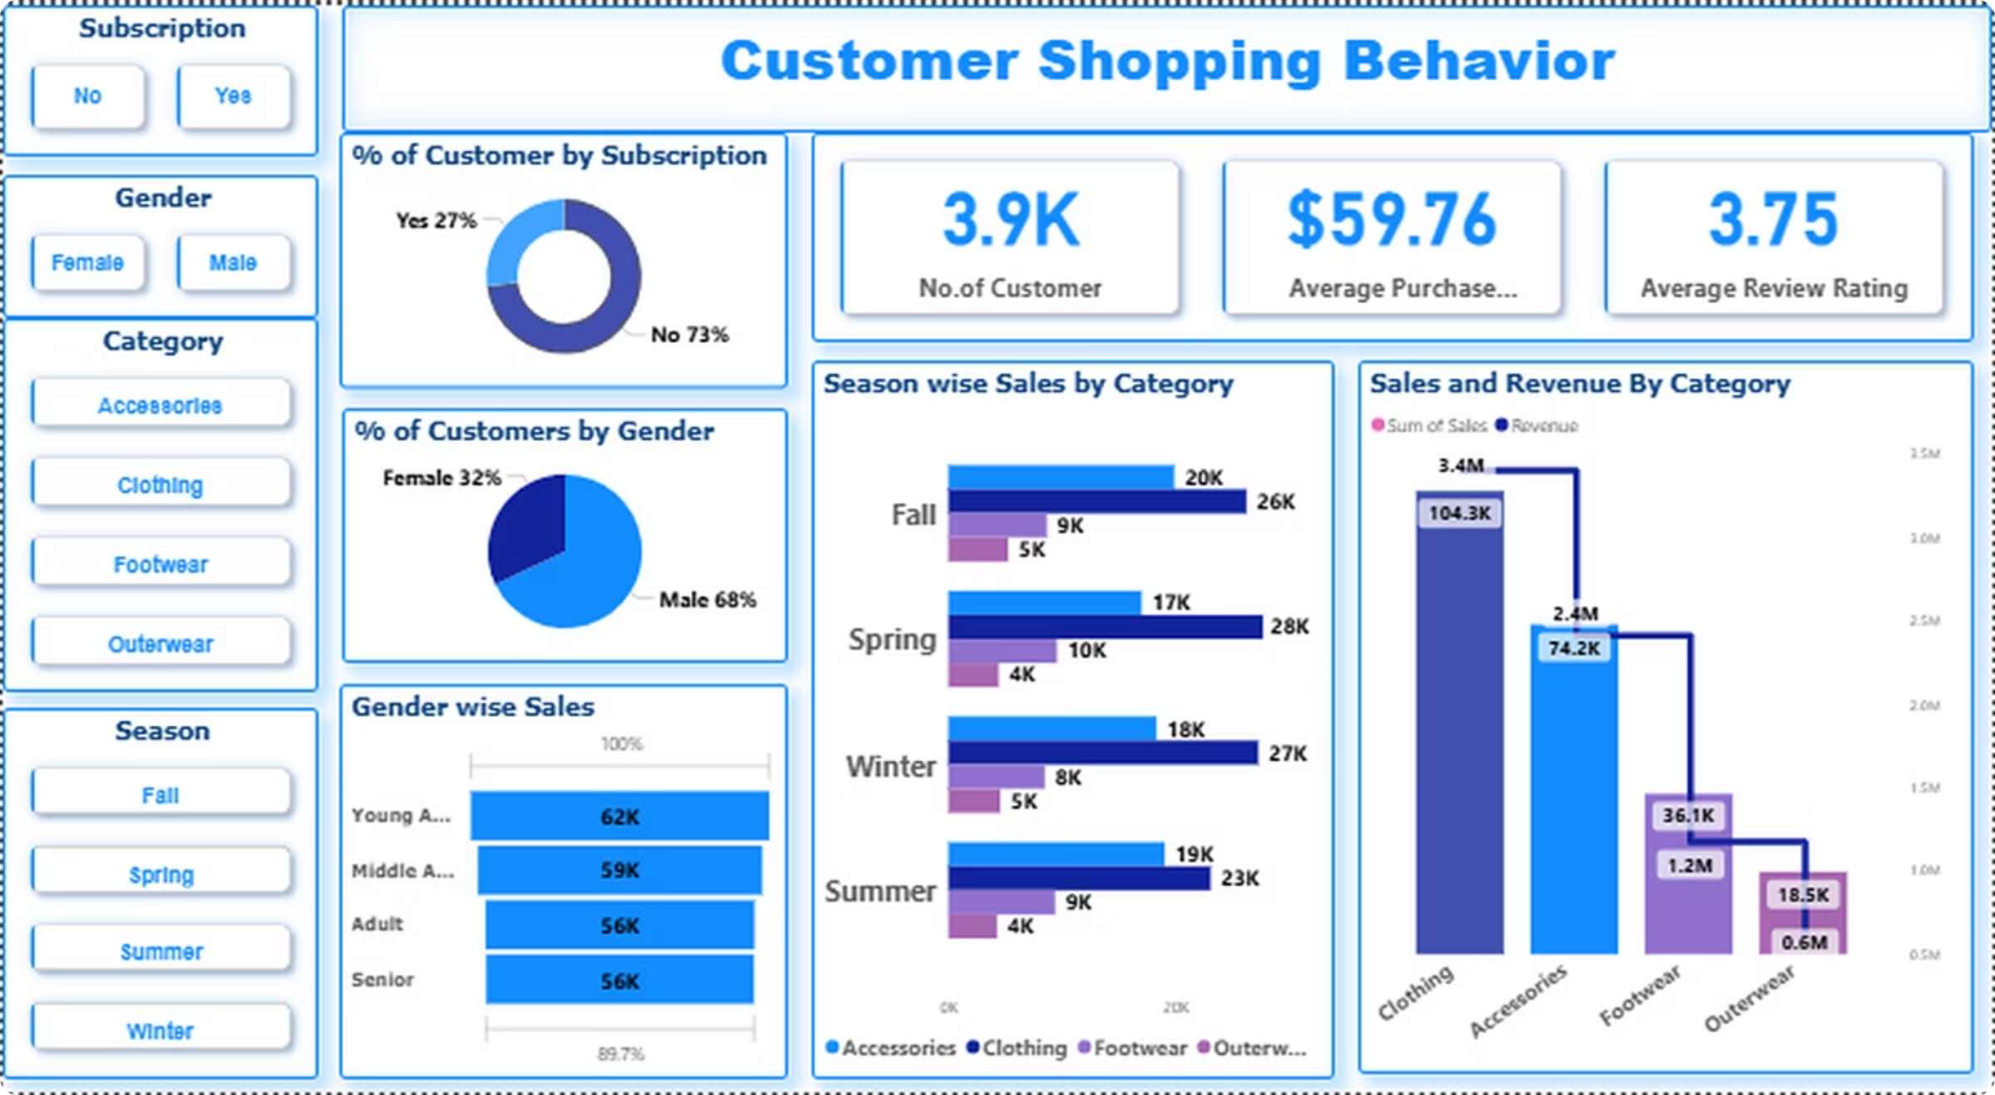
Interactive Dashboard Overview
Key Metrics Tracked
Dynamic Filtering
Customer count and average purchase value
Slicers for gender, season, category, and subscription status enable real-time insights
Category-wise sales and revenue
Season-wise performance trends

Slide 7
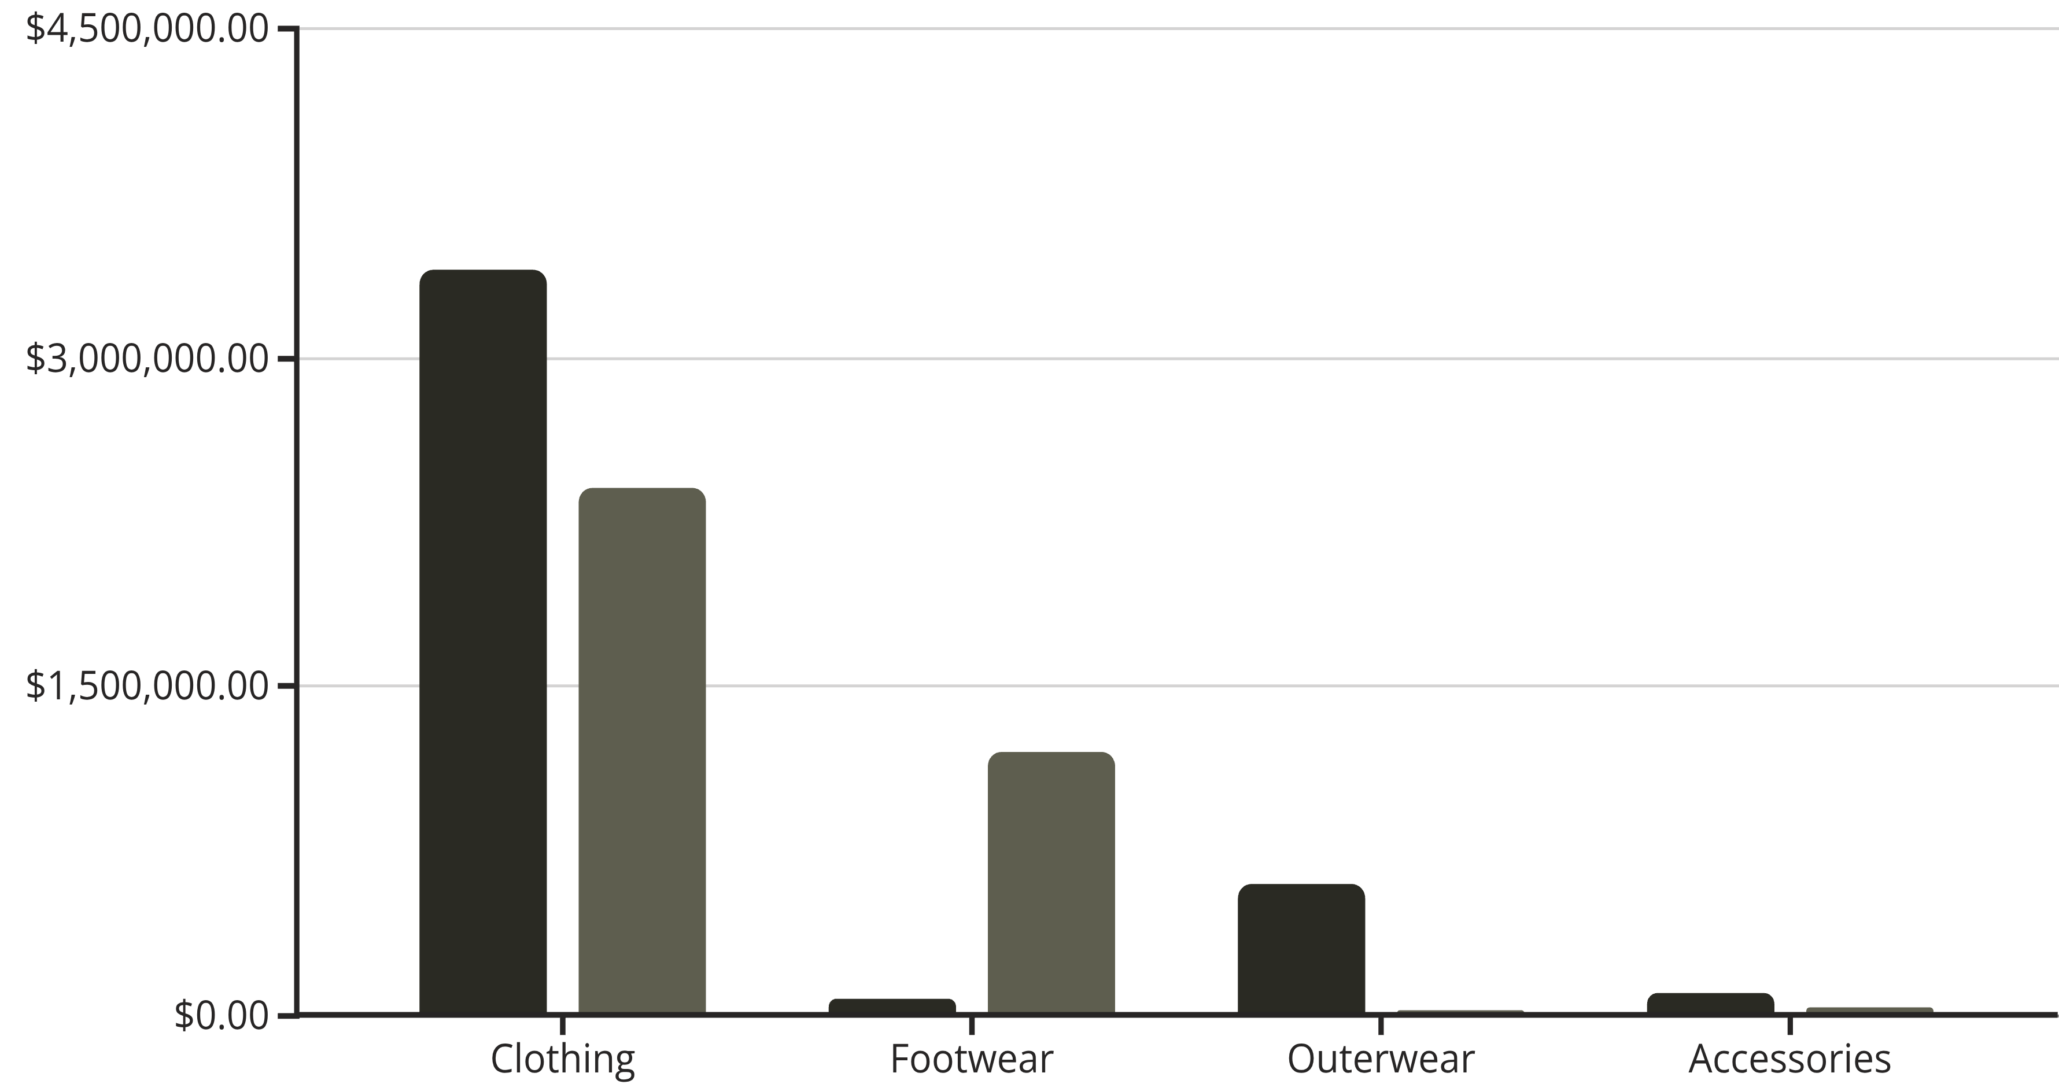
KEY FINDINGS
Revenue Distribution by Category
Sales
Revenue
Clothing and Accessories dominate sales, while Footwear drives significant revenue despite lower volume

Slide 8




Customer Demographics Insights
68%
32%
Male Customers
Female Customers
Majority of customer base
Significant segment
73%
27%
Non-Subscribed
Subscribed
Untapped opportunity
Loyal customer base
Young adults and middle-aged customers drive highest revenue across all categories

Slide 9




STRATEGIC RECOMMENDATIONS
Actionable Business Strategies
Boost Subscriptions
Introduce exclusive benefits to convert 73% non-subscribers
Loyalty Programs
Reward repeat customers to increase retention
Optimize Discounts
Balance promotions to protect margins while driving sales
Seasonal Campaigns
Align marketing with demand trends across seasons

Slide 10


Project Impact & Conclusion
Complete Analytics Lifecycle
This project demonstrates a complete end-to-end data analytics lifecycle, from raw data exploration to actionable business recommendations. The integration of Python, SQL, and Power BI showcases strong analytical, visualization, and business storytelling skills relevant for Data Analyst and Business Analyst roles.
Skills Demonstrated
Python for EDA and preprocessing
SQL for business queries
Power BI for visualization
Business storytelling
Key Takeaway: This analysis provides strategic insights to optimize marketing, improve customer retention, and drive revenue growth through data-driven decision making

